Slide 1
SIG Integration Hands-on Workshop WSO2 middleware
Sigurd de Jong
Integrationspecialist
18 april 2019

Slide 2
Subjects: - Introduction - Prerequisites - Use case

Slide 3
Introduction
In this workshop we will create an interface to a public webservice. We will be using the following products:
WSO2 Enterprise Integrator
WSO2 Developer Studio (Eclipse)
SoapUI
The public webservice we will use is
https://restcountries.eu

Slide 4
Prerequisites
Virtualbox (Version 6.0.8 r130520 (Qt5.6.2))
WSO2 linux (CentOS 7) image
In the WSO2 Linux image the following software is available:
Java 8
WSO2 Enterprise Integrator 6.4.0
WSO2 Developer Studio version 3.8.0
SoapUi Community 5.5.
Instructions:
https://drive.google.com/open?id=1HkaZXIp9JplKRtNhKG2c37S3Egw3VjVo

Slide 5
Credentials and locations
Username | Password
wso2am | Welkom123
root | Welkom123
VirtualBox
Enterprise
Integrator
Google drive
In our referenceproject you can find textfile “WSO2-readme.txt”.
This also contains credential and location information for cut/paste purposes.
Installation location | Logfile location
/usr/lib64/wso2/wso2ei/6.4.0 | /usr/lib64/wso2/wso2ei/6.4.0/repository/logs
tail -f /usr/lib64/wso2/wso2ei/6.4.0/repository/logs/wso2carbon.log
Admin Console | URL | Login
Enterprise integrator | https://localhost:9443/carbon | admin:admin
Location for downloading prerequisites
https://drive.google.com/open?id=1P2DnFrS8_Djw6MefrMO53QzTLGlD1gg5

Slide 6
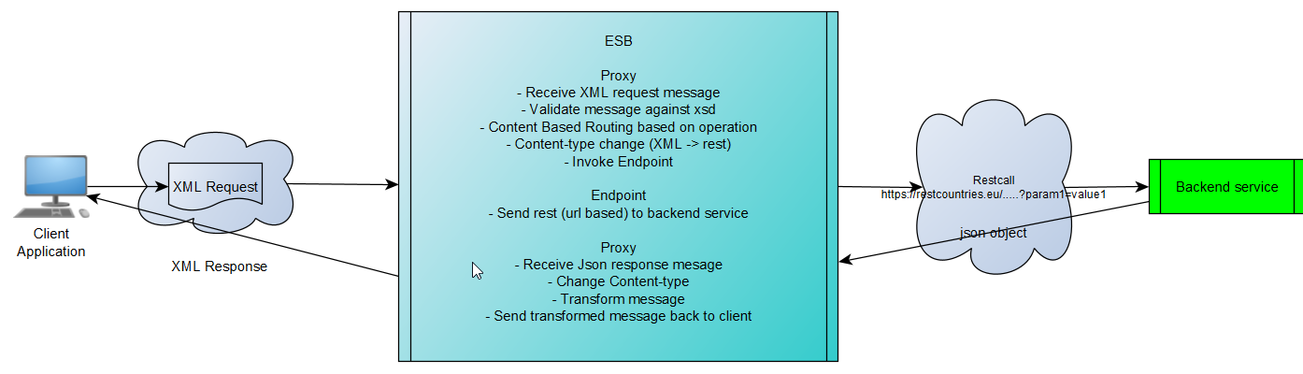
Use Case
In this use-case we will create an interface to backend api https://restcountries.eu. This is a restfull api providing information on all countries in the world.
Description of the backend service (https://restcountries.eu)

Slide 7
The backend service exposes serveral Api endpoints. We will use four of those for our use case.
Search by list of ISO 3166-1 2-letter or 3-letter country codes
https://restcountries.eu/rest/v2/alpha?codes={code};{code};{code}
Search by country full name
https://restcountries.eu/rest/v2/name/{name}?fullText=true
Search by ISO 4217 currency code
https://restcountries.eu/rest/v2/currency/{currency}
Search by calling code
https://restcountries.eu/rest/v2/callingcode/{callingcode}

Slide 8
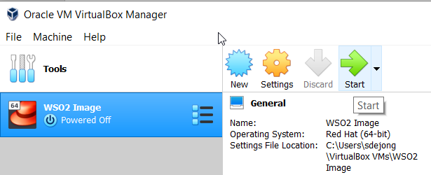
Start your VM
This can take a few minutes
Login as user wso2am using password Welkom123

Slide 9
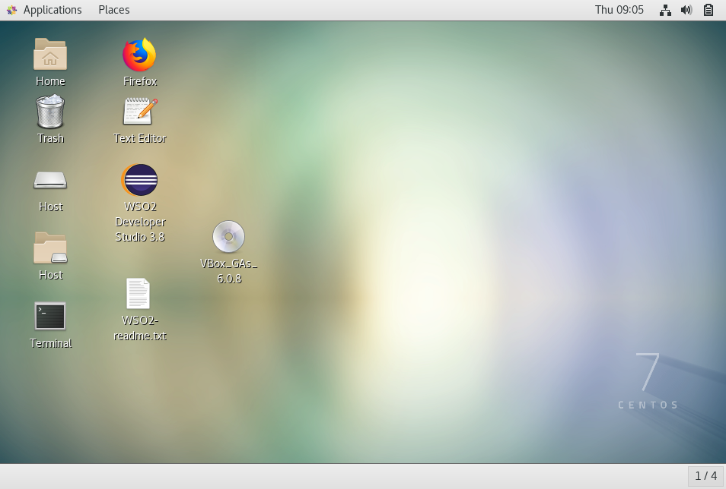

Slide 10
Start WSO2 Developer Suite
Windows: wso2workshop\wso2eidevstudio\eclipse.exe
Linux/Mac: wso2workshop/wso2eidevstudio/eclipse

Slide 11
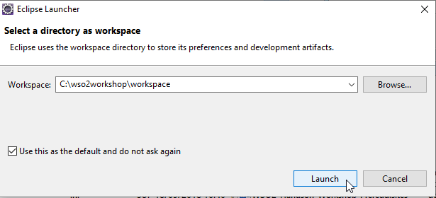
Configure workspace
When you first start Eclipse
it will ask you to configure
your workspace. The work-
space is the root folder for
storing projects, these will
be stored in subfolders under this rootfolder.
If you used eclipse before and want to switch to another workspace you can use File / Switch Workspace

Slide 12
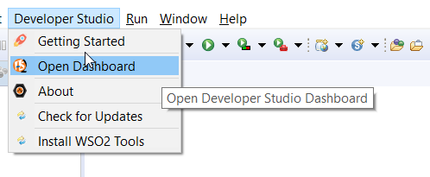
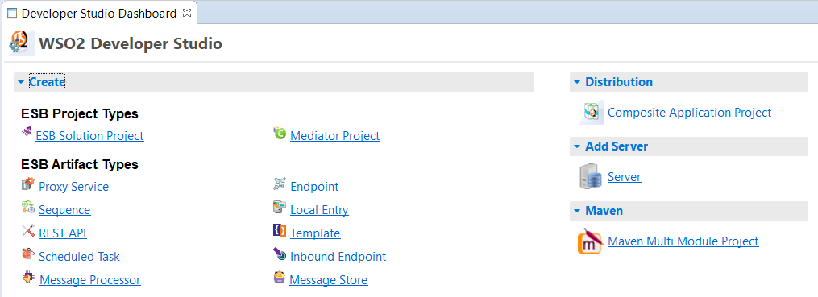
Open WSO2 Developer Studio

Slide 13
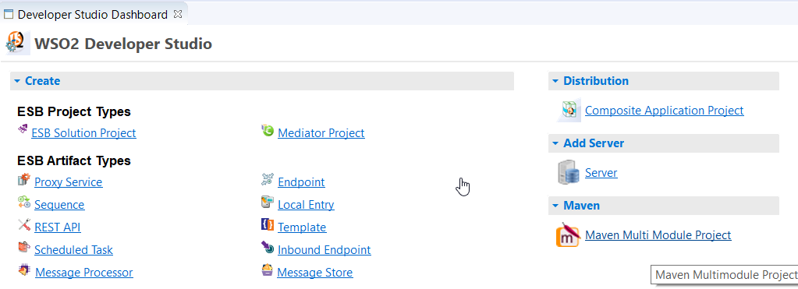
Create root project “CountriesService”
This will be a Multi Module Project

Slide 14
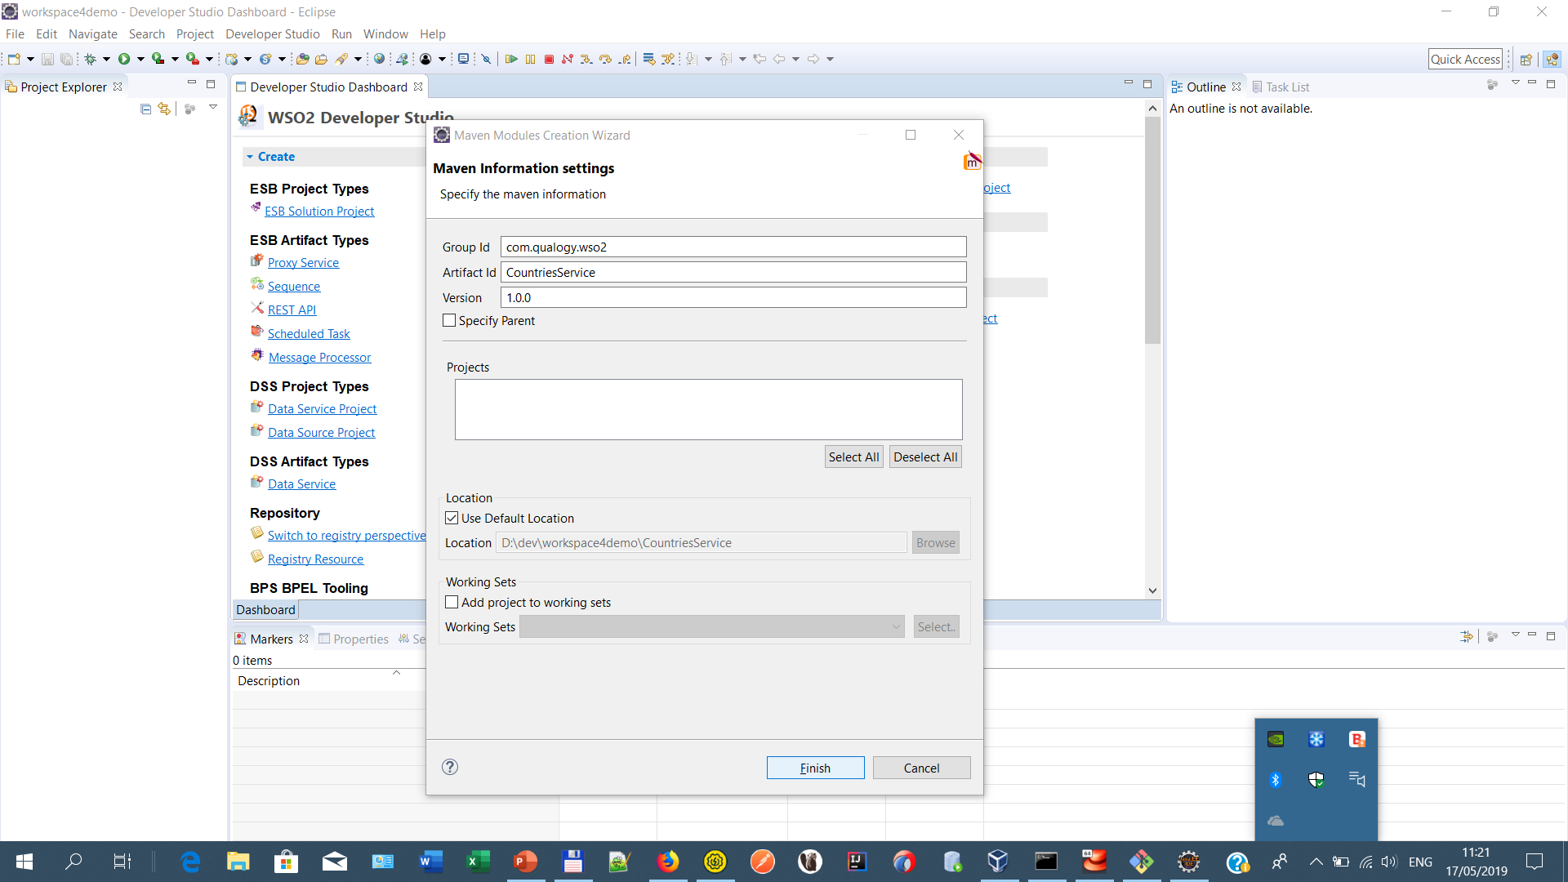
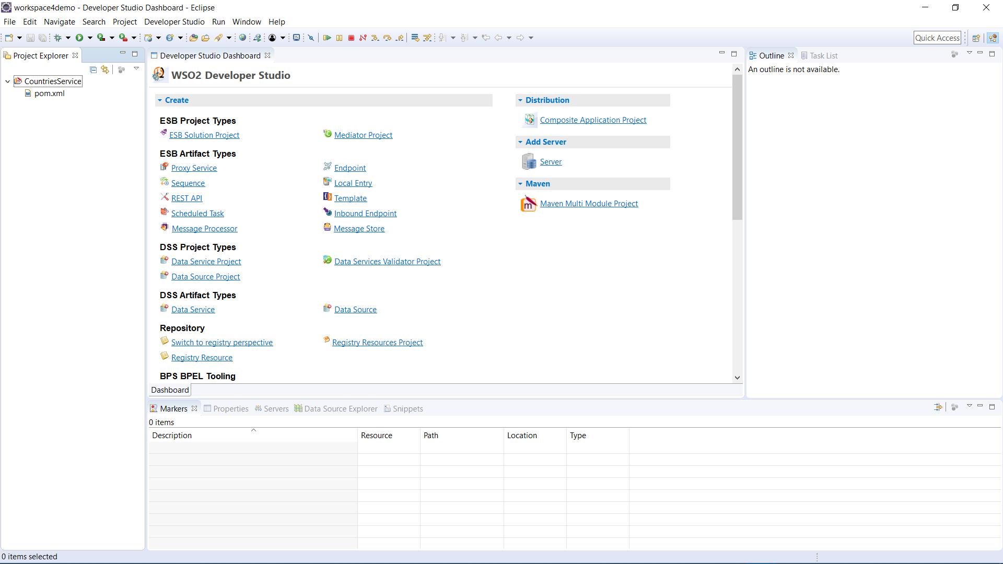
GroupId: com.qualogy.wso2
ArtifactId: CountriesService
Click button
“Finish”

Slide 15
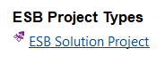
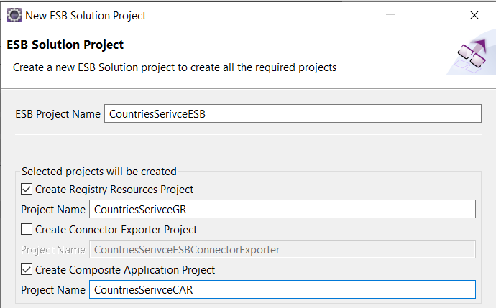
Create projects for Enterprise Service Bus, Goverance Registry and distribution
Click on “ESB Solution Project”
This will enble us to configure our
ESB components
ESB Project Name:
CountriesServiceESB
Create Registry Resources Project:
CountriesServiceGR
Create Composite Application Project:
CountriesServiceCAR
Click button “Next”

Slide 16
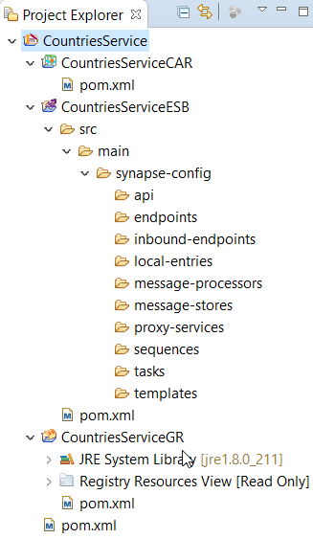
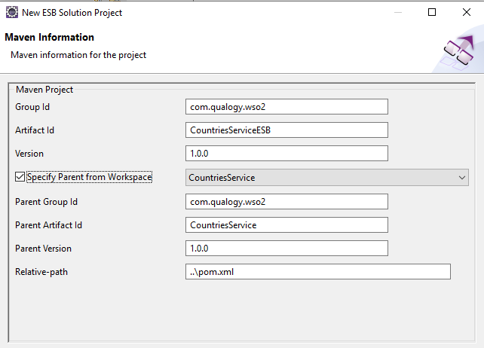
GroupId: com.qualogy.wso2
ArtifactId: CountriesServiceESB
Specify Parent from Workspace: CountriesService
Click button Finish

Slide 17
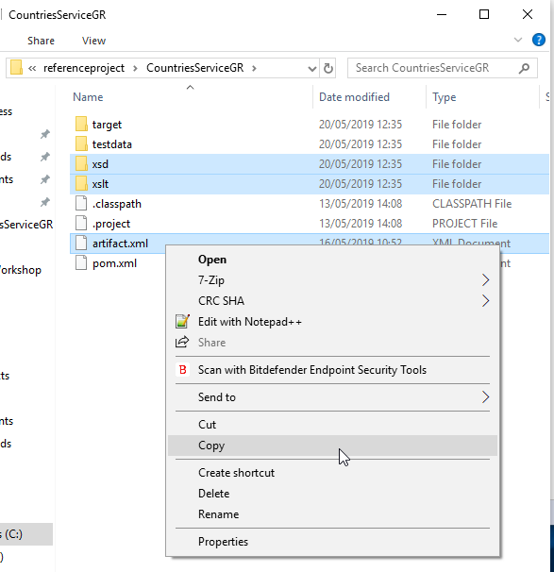
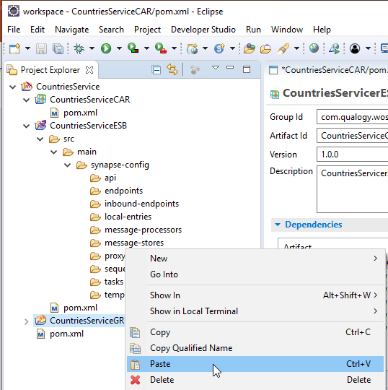
From the file explorer, copy folders xsd and xslt and file artifact.xml from the referenceproject and paste them into the CountriesServiceGR project
Now we have our registry resources in place and we can use them in our
ESB project.

Slide 18
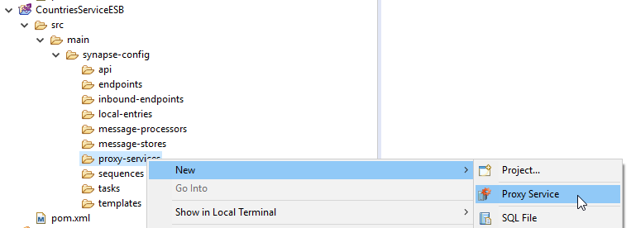
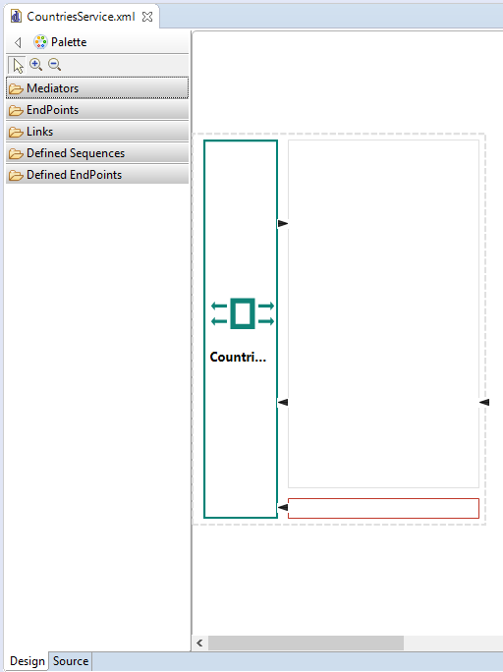
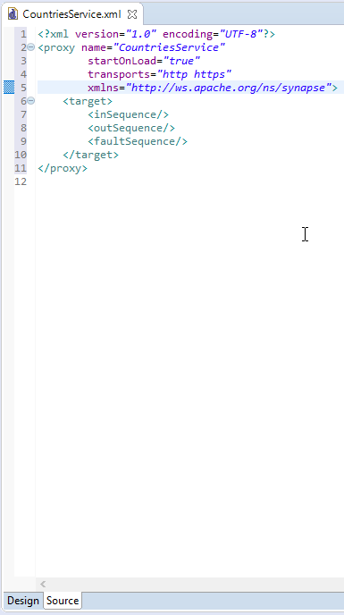
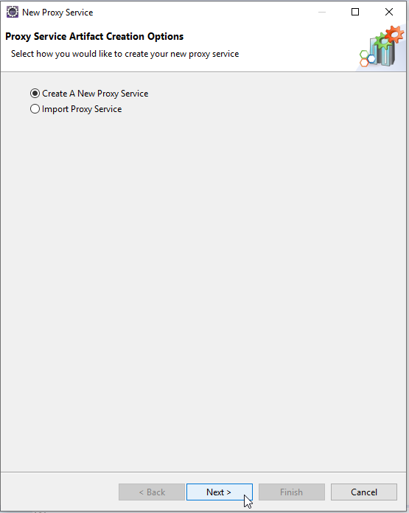
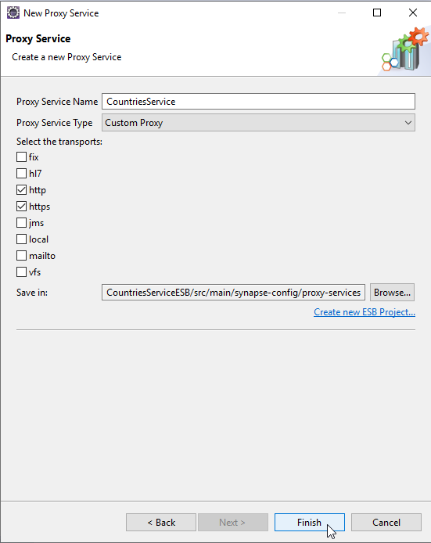
Create proxy service (outline) Name=CountriesService, be sure to select transports
http and https
Click button “Finish”

Slide 19
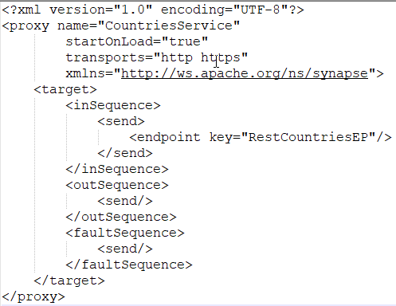
A proxy service is the WSO2 ESB implementation of a webservice. It contains sections:
inSequence : handles the incoming message
outSequence : handles the response message
faultSequence : handles transport errors
First thing we will do now is handle the incoming message. In the insequence a messagecontext object is created by WSO2 and is available to us. All mediators we use will have access to this object.

Slide 20
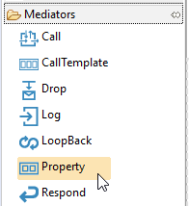
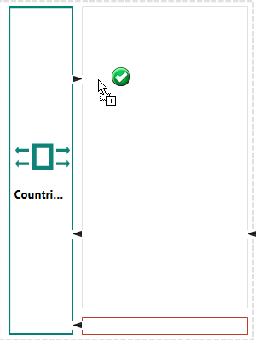
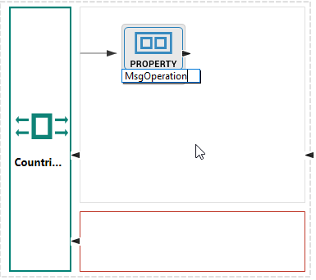
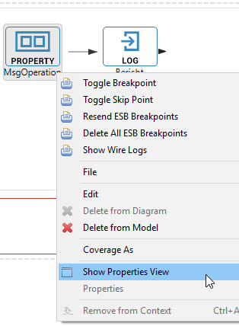
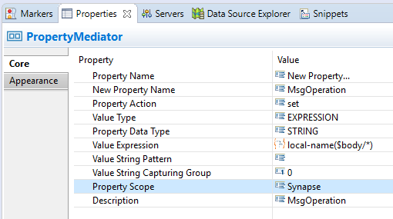
Create a property (variable) to hold the message operation. We will filter based on the operation to be able to dynamically build our endpoint uri.

Slide 21
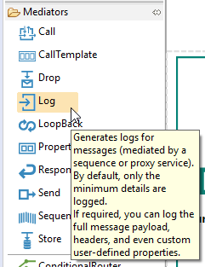
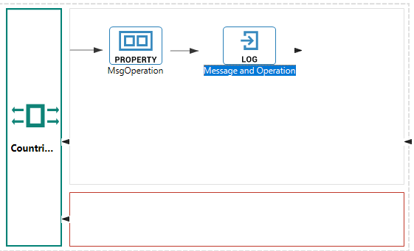
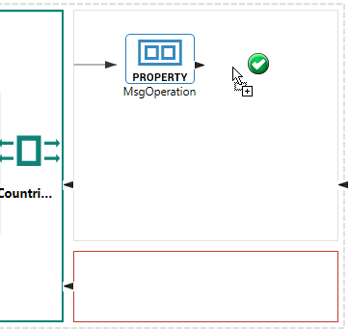
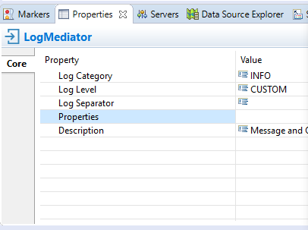
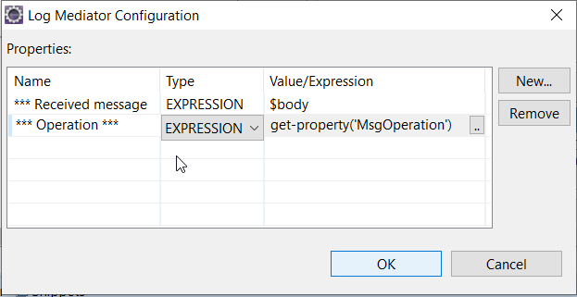
Log the message and the property value to verify if our code works

Slide 22
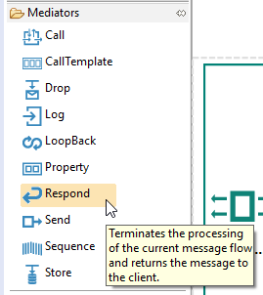
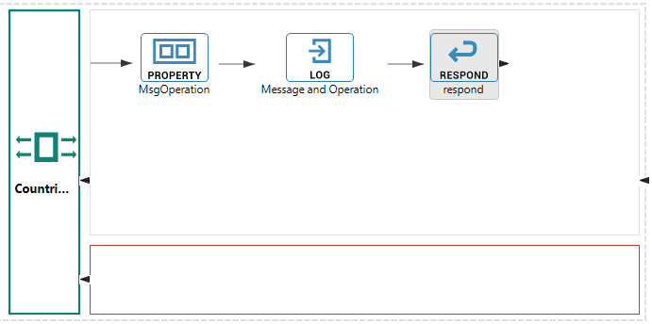
Add Respond mediator to be able to perform our first test.

Slide 23
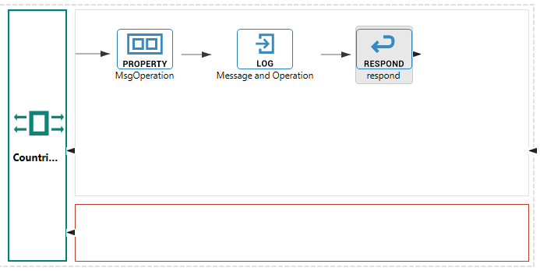
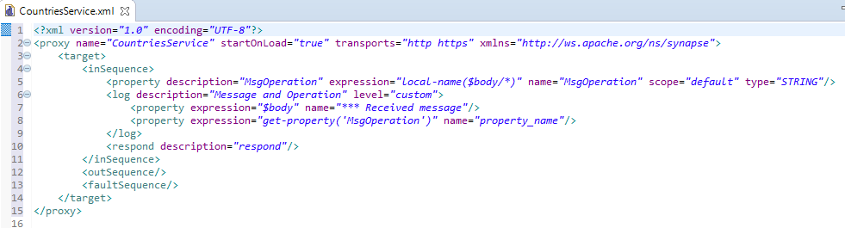
Result so far

Slide 24
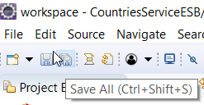
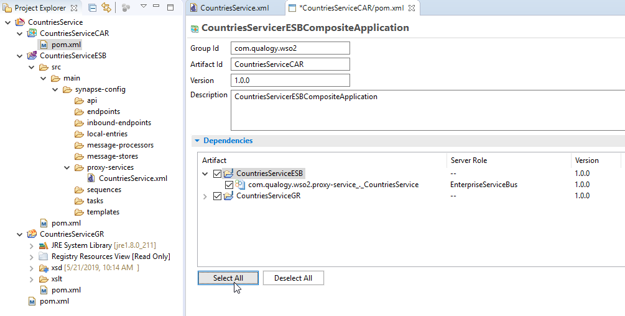
Let’s deploy and test …
Open project CountriesServiceCAR (pom file)
Select all dependencies (Click button “Select All”) and save all unsaved files.

Slide 25
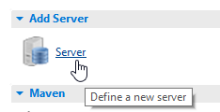
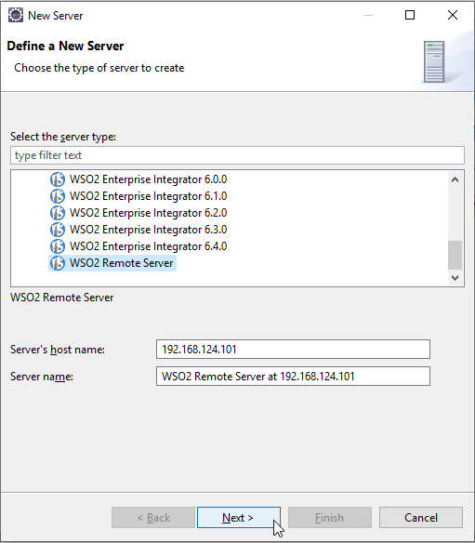
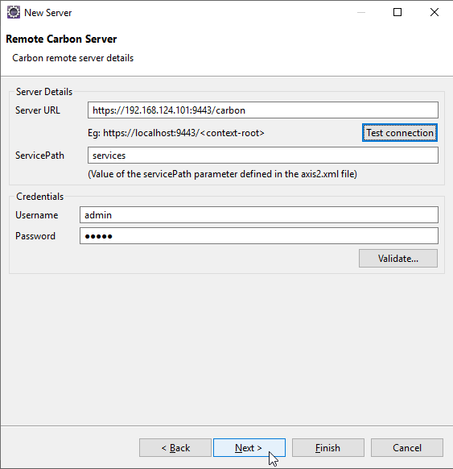
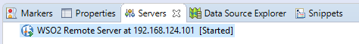
We add a server to our project
for deployment

Slide 26
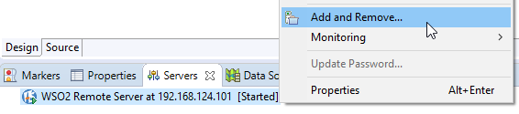
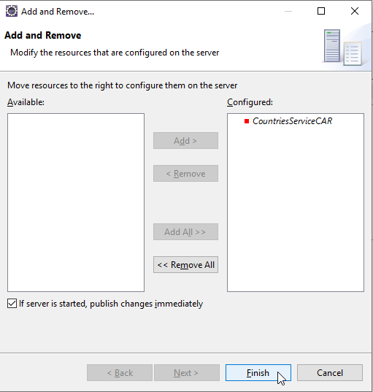
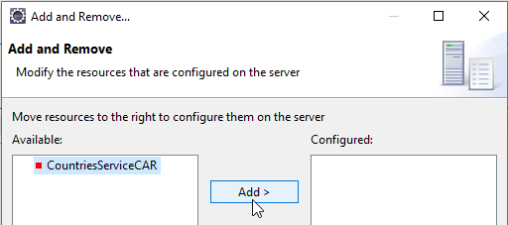
Configure the server to hot deploy our project (CAR)

Slide 27
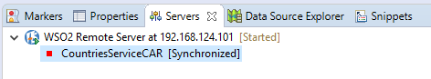
Server is now configured and the project has status Synchronized
Now lets see the result in the WSO2 Enterprise Integrator Administrator Console.
Open your browser and type address:
https://192.168.124.101:9443/carbon
in the address-bar

Slide 28
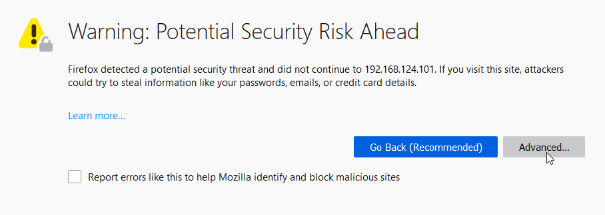
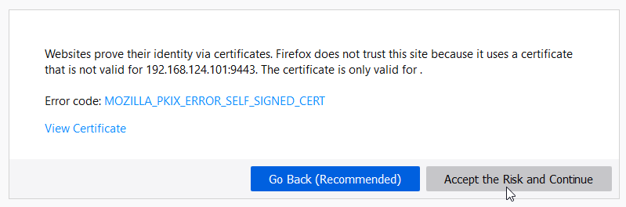
Your browser may warn you about potential risks…

Slide 29
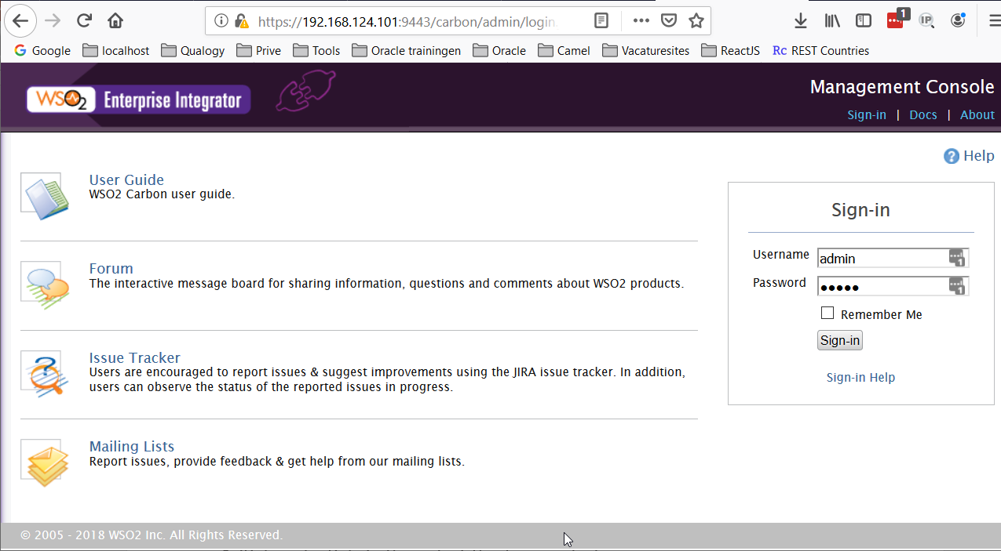
You can now login into the Administration console…
Initial credentials in the out-of-the-box product are
Username : admin
Password : admin

Slide 30
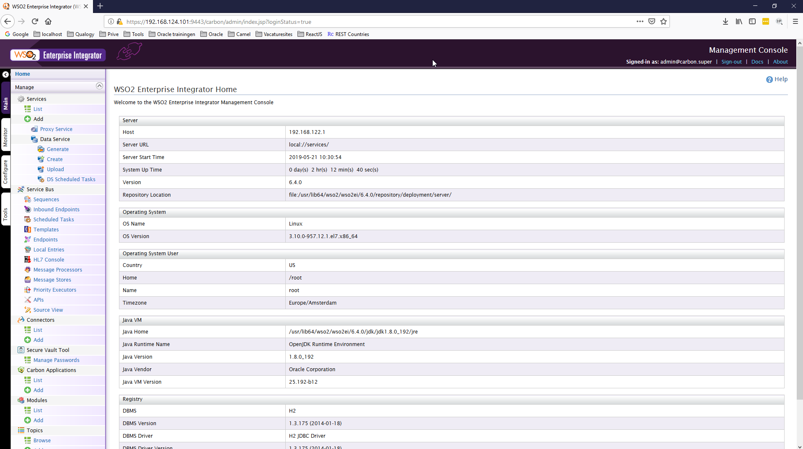
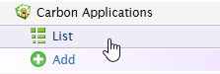
Locate menu-item Carbon Applications under tab Manage. Click the “list” link.

Slide 31



This will list the deployed Carbon applications on this server.
Here we see our application listed. Now lets checkout the components
Locate menu-item Services under tab Manage. Click the “list” link.

Slide 32


Locate the Browse link under tab Registry. Click on it.
Here we see the resources we
copied into the project earlier.

Slide 33

Pre-test:
Lets tail our logfile to see what is logged when we submit a testmessage to our service.
Open a ssh session to our server.
Type the commands:
ssh wso2am@192.168.124.101
Provide user wso2am’s password (Welkom123)
tail –f /usr/lib64/wso2/wso2ei/6.4.0/repository/logs/wso2carbon.log

Slide 34


Test:
Start SoapUI and import project CountriesService-Test-soapui-project.xml located in the referenceproject folder under subfolder CountriesServiceTest.
(wso2workshop\referenceproject\CountriesServiceTest\CountriesService-Test-soapui-project.xml)

Slide 35

Test:
Double-click teststep “CountryCodeTest”

Slide 36

Test:
Submit the request …

Slide 37



Test:
Response…

Slide 38

Now that our first test succeeded we can now continue building our proxy
Content based routing, based on MsgOperation

Slide 39


Open proxyservice CountriesService
Add a switch mediator before the Respond mediator

Slide 40




Slide 41
In every case node within the switch we will populate a property with the value we need to dynamically build our endpoints uri.
Drag a Property mediator into the first case node.
Name : requestValue
Value Expression : $body/code:countryCodeRequest/code:code
Namespace : xmlns:code:http://wso2.qualogy.com/country/code

Slide 42

To populate the dynamic part of our end point uri we need two properties:
Drag two property mediators into the first case node.
Name : requestValue
Value Expression : $body/code:countryCodeRequest/code:code
Namespace : xmlns:code:http://wso2.qualogy.com/country/code
Name : uri.var.queryparams
Value Expression : fn:concat('alpha?codes=',get-property('requestValue’))

Slide 43



Slide 44


Drag a Log mediator into the first case node. Add two properties to the log mediator:
Name : *** code
Value Expression : get-property('requestValue')
Name : *** uri.var.queryparams
Value Expression : fn:concat('alpha?codes=',get-property('requestValue'))

Slide 45


With operation countryNameRequest we must do one extra thing. The message contains tag <FullText>. If this has value true then the uri.var.queryparam property must be appended with “?fulltext=true”
Filter condition:

Slide 46


Then:
PropertyName : uri.var.queryparams
ValueExpression: fn:concat('name/',get-property('requestValue'),'?fullText=true’)
Else:
PropertyName : uri.var.queryparams
ValueExpression: fn:concat('name/',get-property('requestValue'))

Slide 47
Let’s finish the other case nodes and test
Case node: countryCodeRequest √
requestValue : $body/code:countryCodeRequest/code:code
Namespace : xmlns:code="http://wso2.qualogy.com/country/code
uri.var.queryparams: fn:concat(‘currency/',get-property('requestValue'))
Case node: countryNameRequest
requestValue : $body/name:countryNameRequest/name:name
namespace : xmlns:name=http://wso2.qualogy.com/country/name
fullText : $body/name:countryNameRequest/name:fulltext
namespace : xmlns:name=http://wso2.qualogy.com/country/name
uri.var.queryparams: fn:concat('name/',get-property('requestValue'),'?fullText=true')
Case node: countryCurrencyRequest
requestValue : $body/curr:countryCurrencyRequest/curr:currency
namespace : xmlns:curr=http://wso2.qualogy.com/country/currency
uri.var.queryparams: fn:concat(‘currency/',get-property('requestValue'))
Case node: countryCallingCode
requestValue : $body/callcode:countryCallingCodeRequest/callcode:callingcode
Namespace : xmlns:callcode="http://wso2.qualogy.com/country/callingcode
uri.var.queryparams: fn:concat(‘currency/',get-property('requestValue'))

Slide 48

Open project CountriesServiceCAR (pom file) and select all artifacts by clicking button “Select All” and save the file.

Slide 49

In the Servers tab right click our project and select contextmenu item Redeploy

Slide 50
Pre-test:
Lets tail our logfile to see what is logged when we submit a testmessage to our service.
Open a ssh session to our server.
Type the commands:
ssh wso2am@192.168.124.101
Provide user wso2am’s password (Welkom123)
tail –f /usr/lib64/wso2/wso2ei/6.4.0/repository/logs/wso2carbon.log

Slide 51

Test using the four SoapUI teststeps. Response should be the message we send and in the logfile we should see
Operation countryCodeRequest:
*** code = fr, *** uri.var.queryparam = alpha?codes=fr
Operation countryNameRequest:
*** name = United, *** uri.var.queryparam = name/United
*** uri.var.queryparam = name/United?fullText=true
Operation countryCurrencyRequest:
*** curr = EUR, *** uri.var.queryparam = currency/EUR
Operation countryCallingCodeRequest:
*** callcode = 31, *** uri.var.queryparam = callingcode/31

Slide 52

The next step is to validate the incoming message against the schema. We have added the schemafiles (.xsd) into the CountriesServiceGR project.
We will create a template (compairable to a function) to handle validation. We will pass the path to the xsd file to the template as a parameter.

Slide 53


Template name will be ValidateMessageTemplate and template type will be Sequence Template

Slide 54

Template parameter will be schemadef
Once closed Parameters Configuration window the value will nog show up in the Template Parameters field. This is feature ☺

Slide 55



Slide 56




Slide 57



Slide 58




Slide 59



Slide 60





Slide 61



Now we can update our proxy service and call the template we just created.
Select the CallTemplate mediator and
drag it into the first case node within
the switch. Place it as the first item.

Slide 62
Do the same for the other case nodes using the following parametervalues:
Case node: countryCodeRequest
schemadef : gov:/qualogy/countryservice/xsd/CountryCode.xsd
Case node: countryNameRequest
schemadef : gov:/qualogy/countryservice/xsd/CountryName.xsd
Case node: countryCurrencyRequest
schemadef : gov:/qualogy/countryservice/xsd/CountryCurrency.xsd
Case node: countryCallingCodeRequest
schemadef : gov:/qualogy/countryservice/xsd/CountryCallingCode.xsd

Slide 63

The designmode should now look something like this…

Slide 64
In our switch we specified four operations, but what if the operation in the received message does not equal one those four?
In the default node within the switch we will
Log an error message
Call a template inserting parameters
Errorcode
Errormessage
Drop the original message
We will first create the template. Name will be ReturnErrorTemplate, will accept two parameters and will construct an errormessage that will be sent back to the client. No call to the backend service will be made.

Slide 65



Create a new template with name ReturnErrorTemplate.

Slide 66


Add two parameters to the template
errorCode
errorMessage

Slide 67



Add Log, Fault and Send mediator to the template

Slide 68


Add Log, Fault and Send mediator to the template

Slide 69


Add Log, Fault and Send mediator to the template

Slide 70

Template xml will now look like this:

Slide 71



Now we will populate the default node within the switch in our proxy service.

Slide 72



Now we will populate the default node within the switch in our proxy service.

Slide 73


Now we will populate the default node within the switch in our proxy service.

Slide 74

Our default node within the switch will look something like this:

Slide 75

Open project CountriesServiceCAR (pom file) and select all artifacts by clicking button “Select All” and save the file.

Slide 76
In the Servers tab right click our project and select contextmenu item Redeploy

Slide 77
Pre-test:
Lets tail our logfile to see what is logged when we submit a testmessage to our service.
Open a ssh session to our server.
Type the commands:
ssh wso2am@192.168.124.101
Provide user wso2am’s password (Welkom123)
tail –f /usr/lib64/wso2/wso2ei/6.4.0/repository/logs/wso2carbon.log

Slide 78

Test:
Start SoapUI and open project CountriesService-Test-soapui-project.xml
(wso2workshop\referenceproject\CountriesServiceTest\CountriesService-Test-soapui-project.xml)
Submit all teststeps in testSuite “CountriesService-Invalid-Messages-TestSuite”.
All teststeps should succeed:

Slide 79
Now we have succesfully created the code to
Validate the message
Construct the endpoint uri based on the messagecontent
We are ready to create the endpoint so we can make the actual call to the backend service.

Slide 80



Create a new endpoint called “RestCountriesEP”
Endpointtype: HTTP Endpoint
URI Template: https://restcountries.eu/rest/v2/{+uri.var.queryparam}

Slide 81

Call the endpoint from our proxy service.
The respond mediator was very usefull for testing but now we do not need it anymore.
Remove the respond mediator.

Slide 82

Remove http header: Accept-Encoding
Set http header Accept : (value=application/json), this will tell our esb that we can expect json payload as response.
Send the message using named endpoint RestCountriesEP

Slide 83

Remove Accept-Encoding header

Slide 84


Set Accept header

Slide 85


Send the message to the backend system using named endpoint CountriesServiceEP.

Slide 86



Send the message to the backend system using named endpoint CountriesServiceEP.

Slide 87



The last step we must take before we can test the connection to the backend service is handling the response. We do this in the outSequence.

Slide 88



Slide 89

We conclude with checking the response message, if not empty then we transform it to our desired form. The Json payload we receive from the backend service will be transformed to xml automatically.
Remove the full log.

Slide 90


Test if the response message contains Xpath jsonArray/jsonElement/name

Slide 91

Test if the response message contains Xpath jsonArray/jsonElement/name
Boolean(get-property(‘record’) will evaluate to true if the property has a value, to false if the property has value null.

Slide 92


Then:
Schema key: gov:/qualogy/countryservice/xslt/CountriesResponse.xslt

Slide 93


Then:

Slide 94


Else:

Slide 95

Open project CountriesServiceCAR (pom file) and select all artifacts by clicking button “Select All” and save the file.

Slide 96
In the Server tab right click our project and select contextmenu item Redeploy

Slide 97
Pre-test:
Lets tail our logfile to see what is logged when we submit a testmessage to our service.
Open a ssh session to our server.
Type the commands:
ssh wso2am@192.168.124.101
Provide user wso2am’s password (Welkom123)
tail –f /usr/lib64/wso2/wso2ei/6.4.0/repository/logs/wso2carbon.log

Slide 98


Test:
Start SoapUI and open project CountriesService-Test-soapui-project.xml
(wso2workshop\referenceproject\CountriesServiceTest\CountriesService-Test-soapui-project.xml)
Submit all teststeps in testSuites “CountriesService-TestSuite” and “CountriesService-Invalid-Messages-TestSuite”.
All teststeps should succeed:

Slide 99

Cool!! you just succesfully created a WSO2 interface

